Slide 1

Recommendation System
A Case study on YouTube Recommendation System

Slide 2
What is a Recommendation System?
Explanation: A recommendation system is an AI-based apparatus that provides recommendations to users on one or more items depending on several data over a period of time. Such systems are mostly available on the internet where they help users in finding relatable content, products or information.
Objectives and Significance:
Promotes User Satisfaction: Offers recommendations in a way that facilitates speedy access to items that meet the needs of the users.
Promotes Activity: Displays relevant items to keep the users active for a longer duration on the platform.
Helps Companies: Assists in enhancing the sales, views or clicks as observed in the case of the existing platforms such as Youtube, Netflix, Amazon, and LinkedIn.
Where You Use Recommendation Systems:
Online Streaming Services: Entertainment contents such as movies, songs and videos according to the consumer tastes and preferences (for example, Netflix, Spotify, Youtube)

Slide 3
Types of Recommendation System
Content-Based Filtering: Recommends items similar to those a user has interacted with, using attributes like skills or industry.
Collaborative Filtering: Suggests items that similar users have liked by identifying patterns in user behavior and interactions.
Hybrid Systems: Combines content-based and collaborative approaches to enhance recommendation accuracy and relevance.
Knowledge-Based Systems: Makes recommendations based on specific user criteria, such as required qualifications, for more tailored matches.
Deep Learning Models: Leverages neural networks to capture complex patterns, providing highly personalized and adaptive recommendations.
We'll explore Content-Based and Collaborative Filtering in more detail in the following slides.

Slide 4
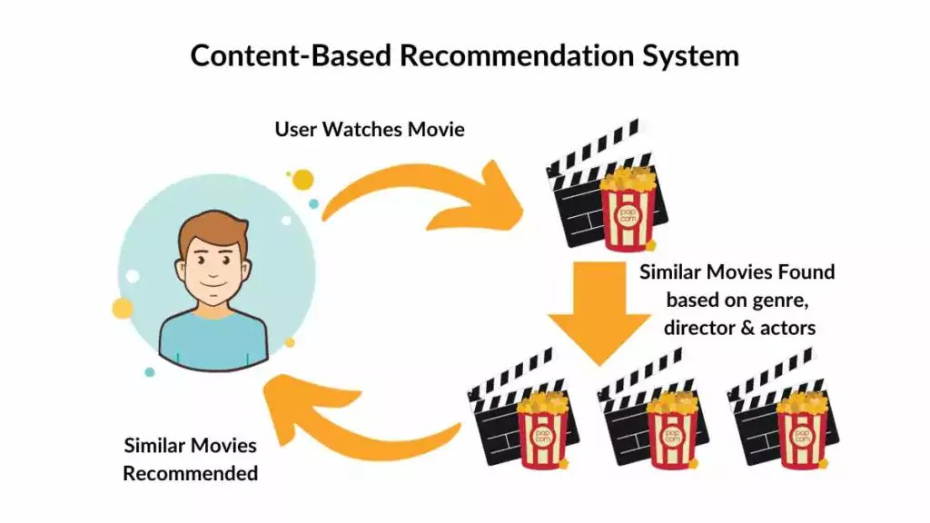
Content-Based Filtering
In Content-Based Filtering systems, recommendations are made based on the user’s profile and attributes of content that the user has consumed in the past. This approach relies on various attributes, which may include skills, job position, industry, among others, to compare and find related content. For example, LinkedIn uses this approach to recommend jobs to a user who has specified skills in her profile irrespective of geographical location thus making the recommendations relevant to the user’s work experience. Content- based strategies are also advantageous to newbies because they are based more on given profile information than broader user experiences.

Slide 5
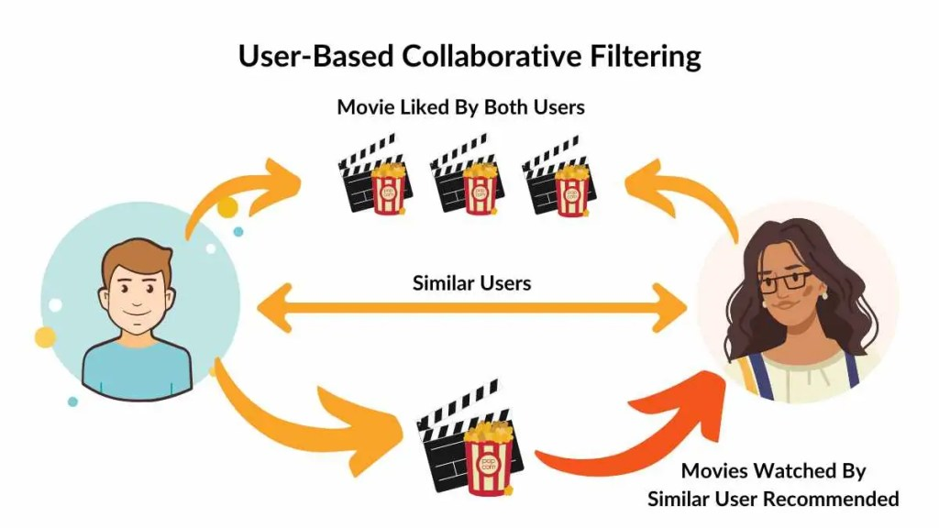
Collaborative Filtering
Collaborative Filtering proposes items based on the evaluation of user behaviors and preferences of like individuals. It does not rely on only a single user’s profile but employs the patterns of interaction such as likes and applications to recommend jobs to the users. For example, when like users apply for certain jobs, those jobs are prone to be shown to other users of that group. This is useful for revealing some information that may not be readily visible in user behavior.

Slide 6
Hybrid Recommendation Systems
A hybrid recommendation system combines multiple recommendation methods, like content-based and collaborative filtering, to improve recommendation accuracy and user satisfaction.
Examples:
Netflix: Combines viewing habits with content metadata.
Amazon: Uses purchase history + item characteristics.
Spotify: Mixes user listening history with song features.
YouTube: Blends user behavior with video attributes.

Slide 7
How Hybrid Recommendation Systems Help YouTube
YouTube’s hybrid recommendation system combines content-based and collaborative filtering to deliver more relevant and personalized video recommendations.
Content-Based Filtering: Analyzes video features (e.g., title, tags, genre) to recommend similar content to what the user previously watched.
Collaborative Filtering: Uses user behavior patterns to suggest videos that other users with similar preferences watched.

Slide 8
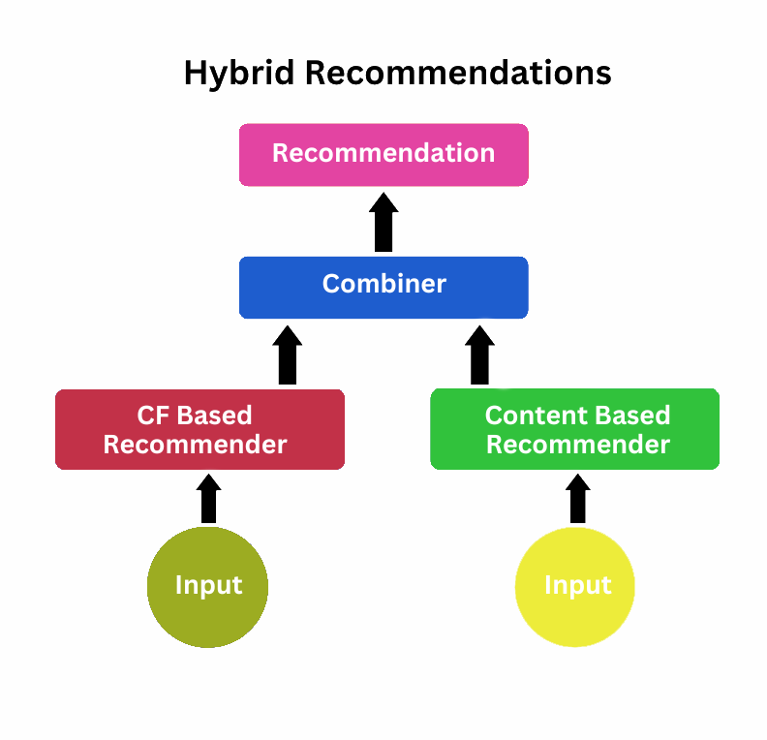

Slide 9
Lets discuses about the Case study
Introduction
To better enhance user engagement through recommended videos, YouTube makes effective use of a Hybrid Recommendation System. The two strategies used are Content-Based Filtering, which focuses on the video tags, titles, and genres, and Collaborative Filtering, using behavior and interaction patterns by the users. Such a model can solve issues related to personalization, cold start problem, and scalability. Increased user satisfaction, retention, and watch time will arise from the hybrid system as used by YouTube from recommending tailored videos.

Slide 10
Lets go Through the CASE!
In this case study, we’re exploring how YouTube can improve its recommendation system to provide more personalized and engaging video suggestions for users. With a massive user base and diverse content, YouTube faces unique challenges, including:
Personalization Needs, Cold Start Issue, Scalability
Case Goals:
Increase User Engagement by presenting relevant, appealing content to each user.
Mitigate Cold Start by leveraging content attributes for recommendations when user data is limited.
Enhance Scalability with an efficient system capable of handling a large volume of data and interactions.

Slide 11
Problem Without a Proper Hybrid Recommendation System
Lack of Personalization: Content-based or collaborative filtering alone would limit recommendation quality.
Cold Start Issue: New users wouldn’t receive accurate recommendations without previous data.
Engagement Drop: Low relevance of recommendations could lead to decreased user engagement.

Slide 12
Data Preparation
Data Gathering:
Video Data: Video ID, title, tags, and category.
User Interaction Data: Watch history, likes, and shares.
Data Preprocessing
Duplicate Removal and missing values
Normalization of Formats such as Lowercase of Tags for Consistency.
Data Wrangling
Tag Processing: splitting the tags to get the keywords, thus to know the video similarity
Interaction Scores: giving high score to videos that have been liked and shared by a user in preference.
Data Organization
User-Item Interaction Matrix: User represents rows, Video represent columns, value that represent interactions.
Content Features Matrix: Video tags and categories matrix to support content-based filtering.

Slide 13
User-Item Interaction Matrix
The User-Item Interaction Matrix captures users' interactions with videos - the basis for collaborative filtering. This matrix gives information to the recommendation system on who has similar preferences, meaning it can identify similar people and recommend relevant videos accordingly. This matrix helps the system find the similarity amongst users based on shared interest and video interactions. The system can determine those users sharing similar tastes to make it collaborative recommendation.
interaction_matrix = pd.DataFrame(0, index=user_data['user_id'], columns=video_data['video_id']).apply(lambda row: [1 if vid in row['watched_videos'] else 0 for vid in video_data['video_id']], axis=1)

Slide 14
Similarity Metric
It all starts with choosing similarity metrics, which forms the cornerstones of giving accurate recommendations. YouTube uses cosine similarity for content-based filtering where all video tags and descriptions are taken as input to ascertain content with similar attributes. Cosine similarity or Jaccard similarity measures how closely users' viewing behaviors align with each other in the case of collaborative filtering. The hybrid scores of YouTube combine these metrics and usually use a weighted average to balance both user-based and content-based insights. This approach comes together with a competitive balance of both user tastes and video relevance.

Slide 15
Implement the Recommendation Algorithm
1. Content-Based Filtering:
Recommends the videos which were similar in content to what the user previously watched.
It uses features such as video tags, descriptions, and categories to allow the finding of relevant content.
2. Collaborative Filtering:
As it recommends videos based upon the patterns or behaviors observed in other users, collaborative filtering analyzes how others similar to the user in question have been watching their content, which videos they liked, and the engagement that occurs.
3. Hybrid Approach:
Hybrid scores are a combination of both content-based and collaborative filtering, using a weighted average where, for example, there is 60% collaboration and 40% content.
It captures the item attributes and the user interactions to offer a balanced recommendation.

Slide 16



Evaluate the Performance:
Precision:
Measures the proportion of recommended videos that are relevant to the user.
Recall:
Assesses how many relevant videos were successfully recommended out of all relevant videos.
F1-Score:
Combines precision and recall into a single metric for balanced evaluation.
Mean Average Precision (MAP):
Measures the average precision across all relevant items for multiple users, providing a broader view of the recommendation system’s performance.

Slide 17
from sklearn.metrics import precision_score, recall_score, f1_score
# Sample true labels (ground truth) and predicted labels (recommended videos)
true_labels = [1, 0, 1, 1, 0, 1] # 1 for relevant videos, 0 for irrelevant
predicted_labels = [1, 0, 1, 0, 0, 1] # Recommendations from the system
# Calculate Precision, Recall, and F1-Score
precision = precision_score(true_labels, predicted_labels)
recall = recall_score(true_labels, predicted_labels)
f1 = f1_score(true_labels, predicted_labels)
print(f'Precision: {precision:.2f}')
print(f'Recall: {recall:.2f}')
print(f'F1 Score: {f1:.2f}')

Slide 18
Result Analysis and Limitations
Result Analysis:
Performance Metrics:
Precision: Relevant recommendations are measured.
Recall: Relevant videos are retrieved.
F1-Score: Overall effectiveness is balanced as a combination of precision and recall.
User Engagement:
Click-through rates and average watch time are analyzed for user engagement.
User feedback has to be understood in the context of satisfaction.
Limitations:
Cold Start Problem: New users and new videos do not have interaction data to make recommendations.
Sparse Data: Sparse interaction matrices do not allow similarities.
Dynamic Content: Always changing content negates the relevance of suggestions.
User Behavior Variability: Preferences of the users may change, but they may not be caught instantly.
Algorithm Complexity: In real time, increase in complexity may deter performance.

Slide 19
Conclusion
An effective combination of both collaborative filtering and content-based filtering approaches was used to design a hybrid YouTube recommendation system. It enhances personalization in terms of content and also user experience and engagement.
It uses the interaction data of the users along with the features of video content and, based on that, it can generate video recommendations highly aligned with the specific individual preference.
Key Takeaways:
Enhanced Personalization. The hybrid approach could really allow a more effective perception of the users' preference, thereby showing increased precision and recall of the recommended items.
Improved User Engagement: The increased click-through rates and watch time mean that users are happier with the recommended content.
Continuous improvement, or monitoring performance of systems periodically as well as from user feedback in relation to algorithms, so as to continually update to keep relevance up to date.

